Slide 1
CR Area Homeschool Cyber Defense
2023-2024 edition/@sky.kaptin at the helm
23-Sep-2023:
Getting Started

Slide 2

WELCOME
This is the first session of the Cedar Rapids Area Homeschool High School Information Technology Club Cyber Defense Competition Team (the CRAHHSITCDCT) for the 2023-2024 season!!!
That’s a mouthful, so we’ll probably just say “Cyber Defense Team” or “IT Club” from now on.

Slide 3

WELCOME
“CDC” stands for “Cyber Defense Competition,” the event you will win next Spring.
Maybe.

Slide 4

WELCOME
Your chance of winning is directly related to:
How much time you put into learning outside of class; and
How much you let your curiosity take you beyond the exact things we discuss.
This Photo by Unknown Author is licensed under CC BY

Slide 5

Time FOR A POP QUIZ
Pre-quiz comment: you might fail this one, especially when I ask you questions about ME.
This Photo by Unknown Author is licensed under CC BY

Slide 6

Time FOR A POP QUIZ
Post-quiz comment: everybody passed with flying colors. Your sense of personal online security hygiene is really good! You even got the questions about me (mostly) right.

Slide 7

Time FOR A POP QUIZ
However, ONE of you should consider beginning to use a password manager. Ahem, cough, and cough.

Slide 8

Time FOR A POP QUIZ
Post-quiz comment: you also did well with questions and discussions about teamwork. Our team needs to be what my supervisor at GoDaddy calls “a trust environment” where it’s safe to ask anything you need to/want to ask.
Also, Dan volunteered to teach you how to work together in ways that I’ve heard humans can. I’m eager to learn with you.

Slide 9
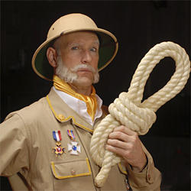
Time FOR A POP QUIZ
And the last post-quiz comment: none of you mentioned that every question on this quiz was question number 1.
They’re all important.

Slide 10

1. How many different passwords do you use for these services?
- Google/Gmail
- TikTok
- Instagram
- Tumblr
- Facebook
- You get the idea
This Photo by Unknown Author is licensed under CC BY-NC-ND

Slide 11
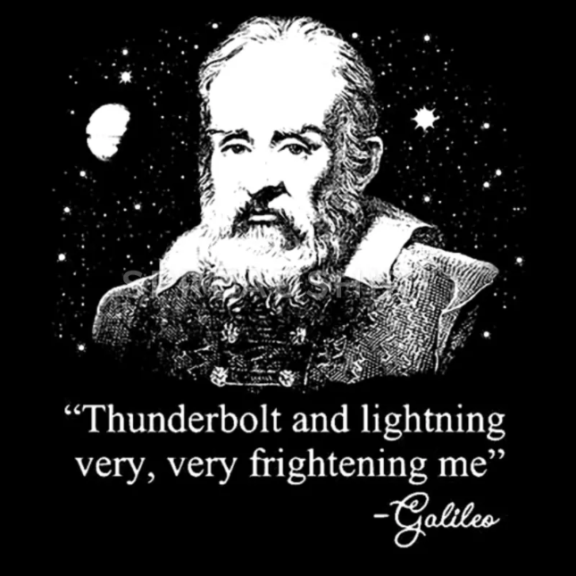
1. Which of the following are actual answers to security questions for one of my online accounts?
- I once had a cat named Bimbo
- The model name of my first car was the Studmobile
- My favorite baseball team is the Cubs
- The name of my first girlfriend is Cindy
Post-quiz comment: your password manager is a good place to store the nonsense answers you make up for security questions. If possible, store them as additional passwords or secrets so that they will be masked (*****) just like passwords are.

Slide 12
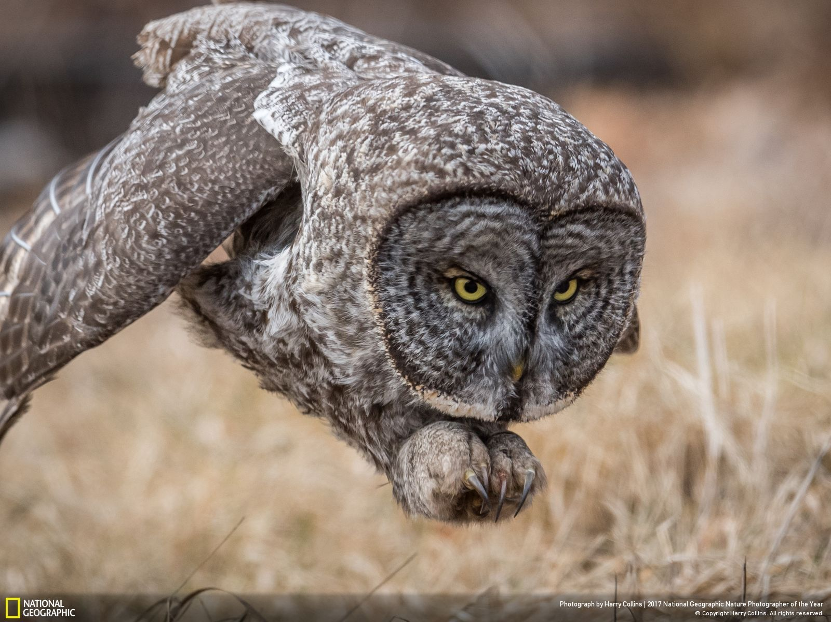
1. How many passwords do you think I have memorized? How many do you have memorized?
- None
- One
- Between two and five
- Between six and ten
- Between 11 and 50
- More than 50

Slide 13

1. Where do you store your passwords?
- Sticky note on computer
- Sticky note on bottom of computer
- Piece of paper you carry around all the time
- In your hippocampus
- Your mom
- Other
This Photo by Unknown Author is licensed under CC BY-NC
This Photo by Unknown Author is licensed under CC BY-NC

Slide 14
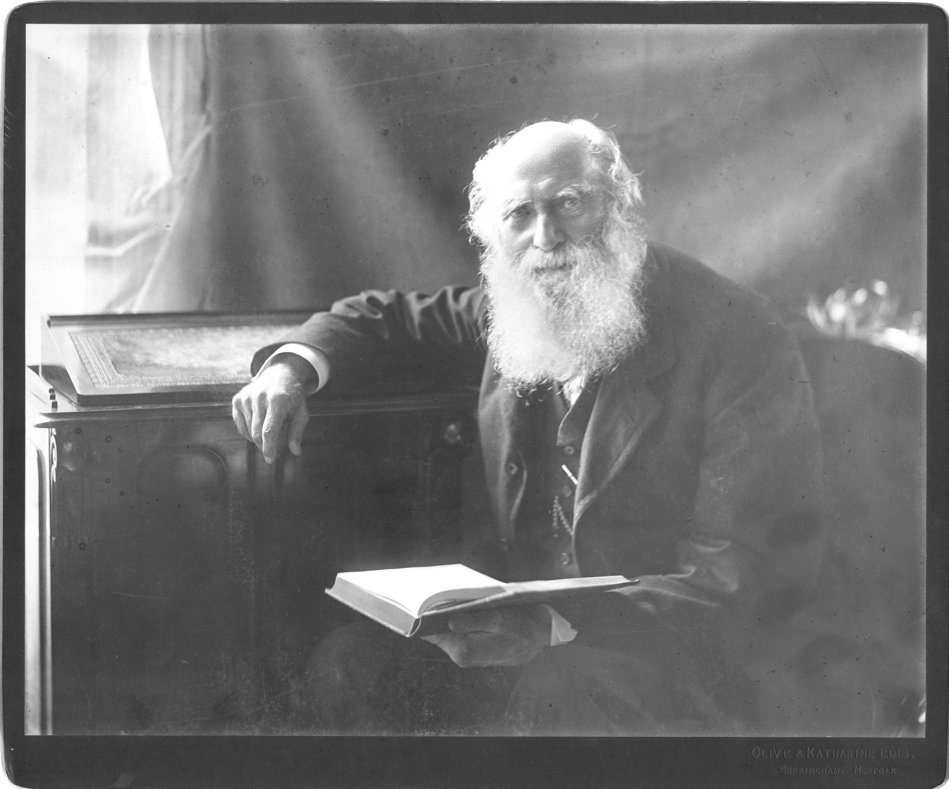
1. How many sites do you log into using OAuth? OAuth is the protocol that lets you use an account from one site to log into some other site. An example would be using your Google account to log into Reddit.
I only log into that site (Google, etc.) with that account
I try to use OAuth as much as I can, so I don’t have many passwords to secure
I use it when I can. Creating lots of logins is a hassle.
What’s a password again? I log into Facebook using Windows Hello, and then Facebook logs me into everything else.
Post-quiz comment: many security people are pushing for a password-free future, although it won’t look like the “Facebook signs me in everywhere” scenario above.

Slide 15

The CDC we’ll compete in has a perfect score of 1,000 points. Which of the following people is the most valuable to our group? (this is a trick question)
Tristan, who knows enough at the beginning of the season to deliver 14 points
Michael, who knows enough to deliver 100 points
Alice, who knows enough to deliver 450 points
Dan, Michael’s dad, who knows how to cheat and flash hand signals to Michael that will add 100 points
Post-quiz comment: the more you learn, the more value you deliver for us at the competition. Go, fictional Tristan, go!

Slide 16
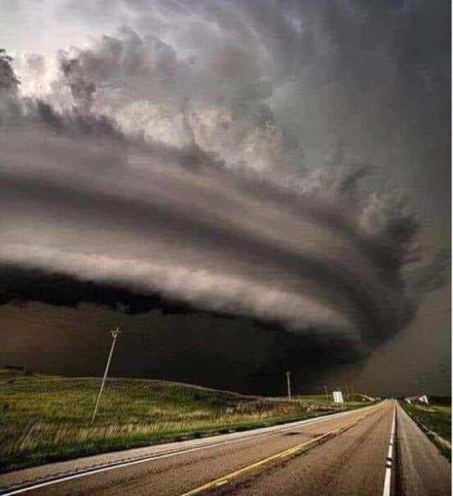
Time FOR BRAINSTORMING
What do you want to learn about?
We’ll go around the room up to five times and ask you for one thing each time that you’d like to study this year.

Slide 17
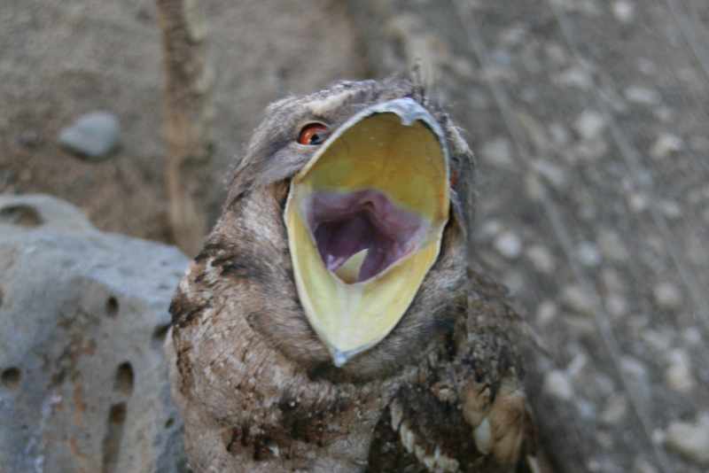
Time FOR BRAINSTORMING
What does Michael want to learn about?
Set up a mail server
Spoofing email

Slide 18

Time FOR BRAINSTORMING
What does Aksel want to learn about?
Hacking and securing PHP
Try to set up an email server

Slide 19

Time FOR BRAINSTORMING
What does Henry want to learn about?
Active Directory security
PowerShell
Setting up a VPN server

Slide 20
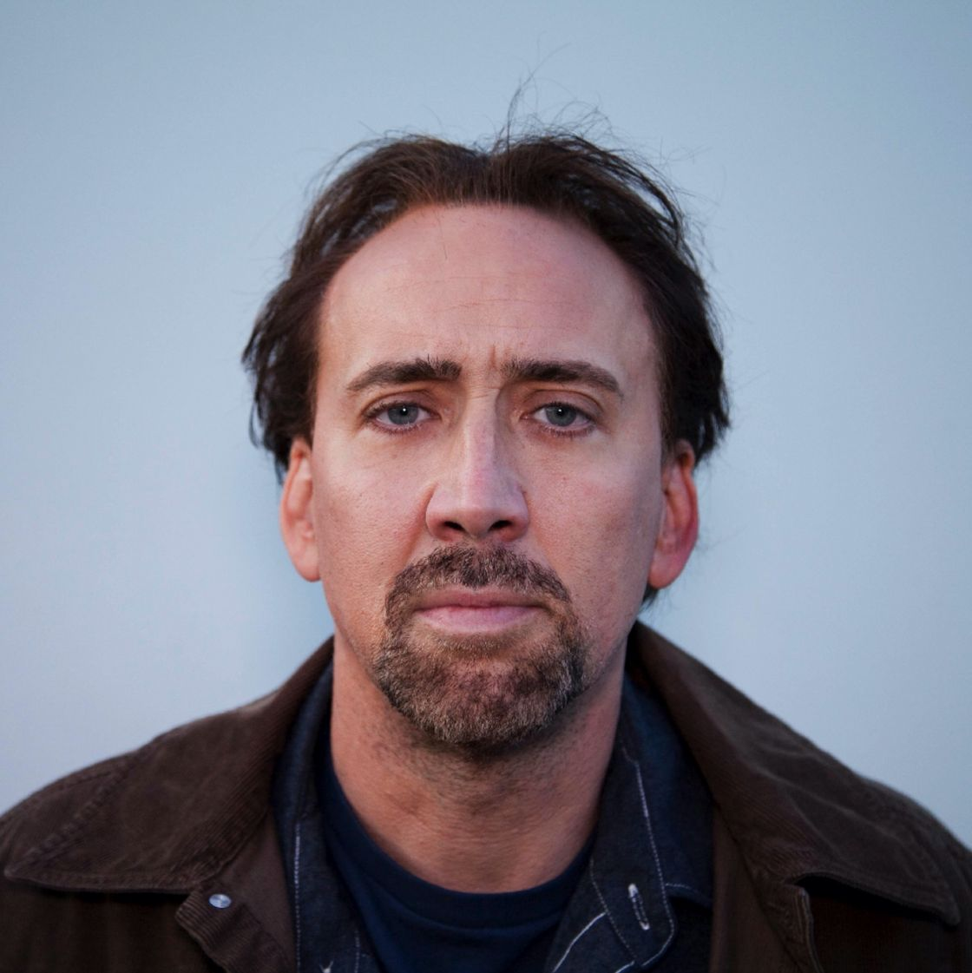
Time FOR BRAINSTORMING
What does Tristan want to learn about?
Automation programming and scripting

Slide 21

Time FOR BRAINSTORMING
What do Chris and Dan want to teach?
Scripting – bash and Powershell
Some Windows (20 to 25 percent?)
How to work together well as a team
How to make sure checklists get checked

Slide 22
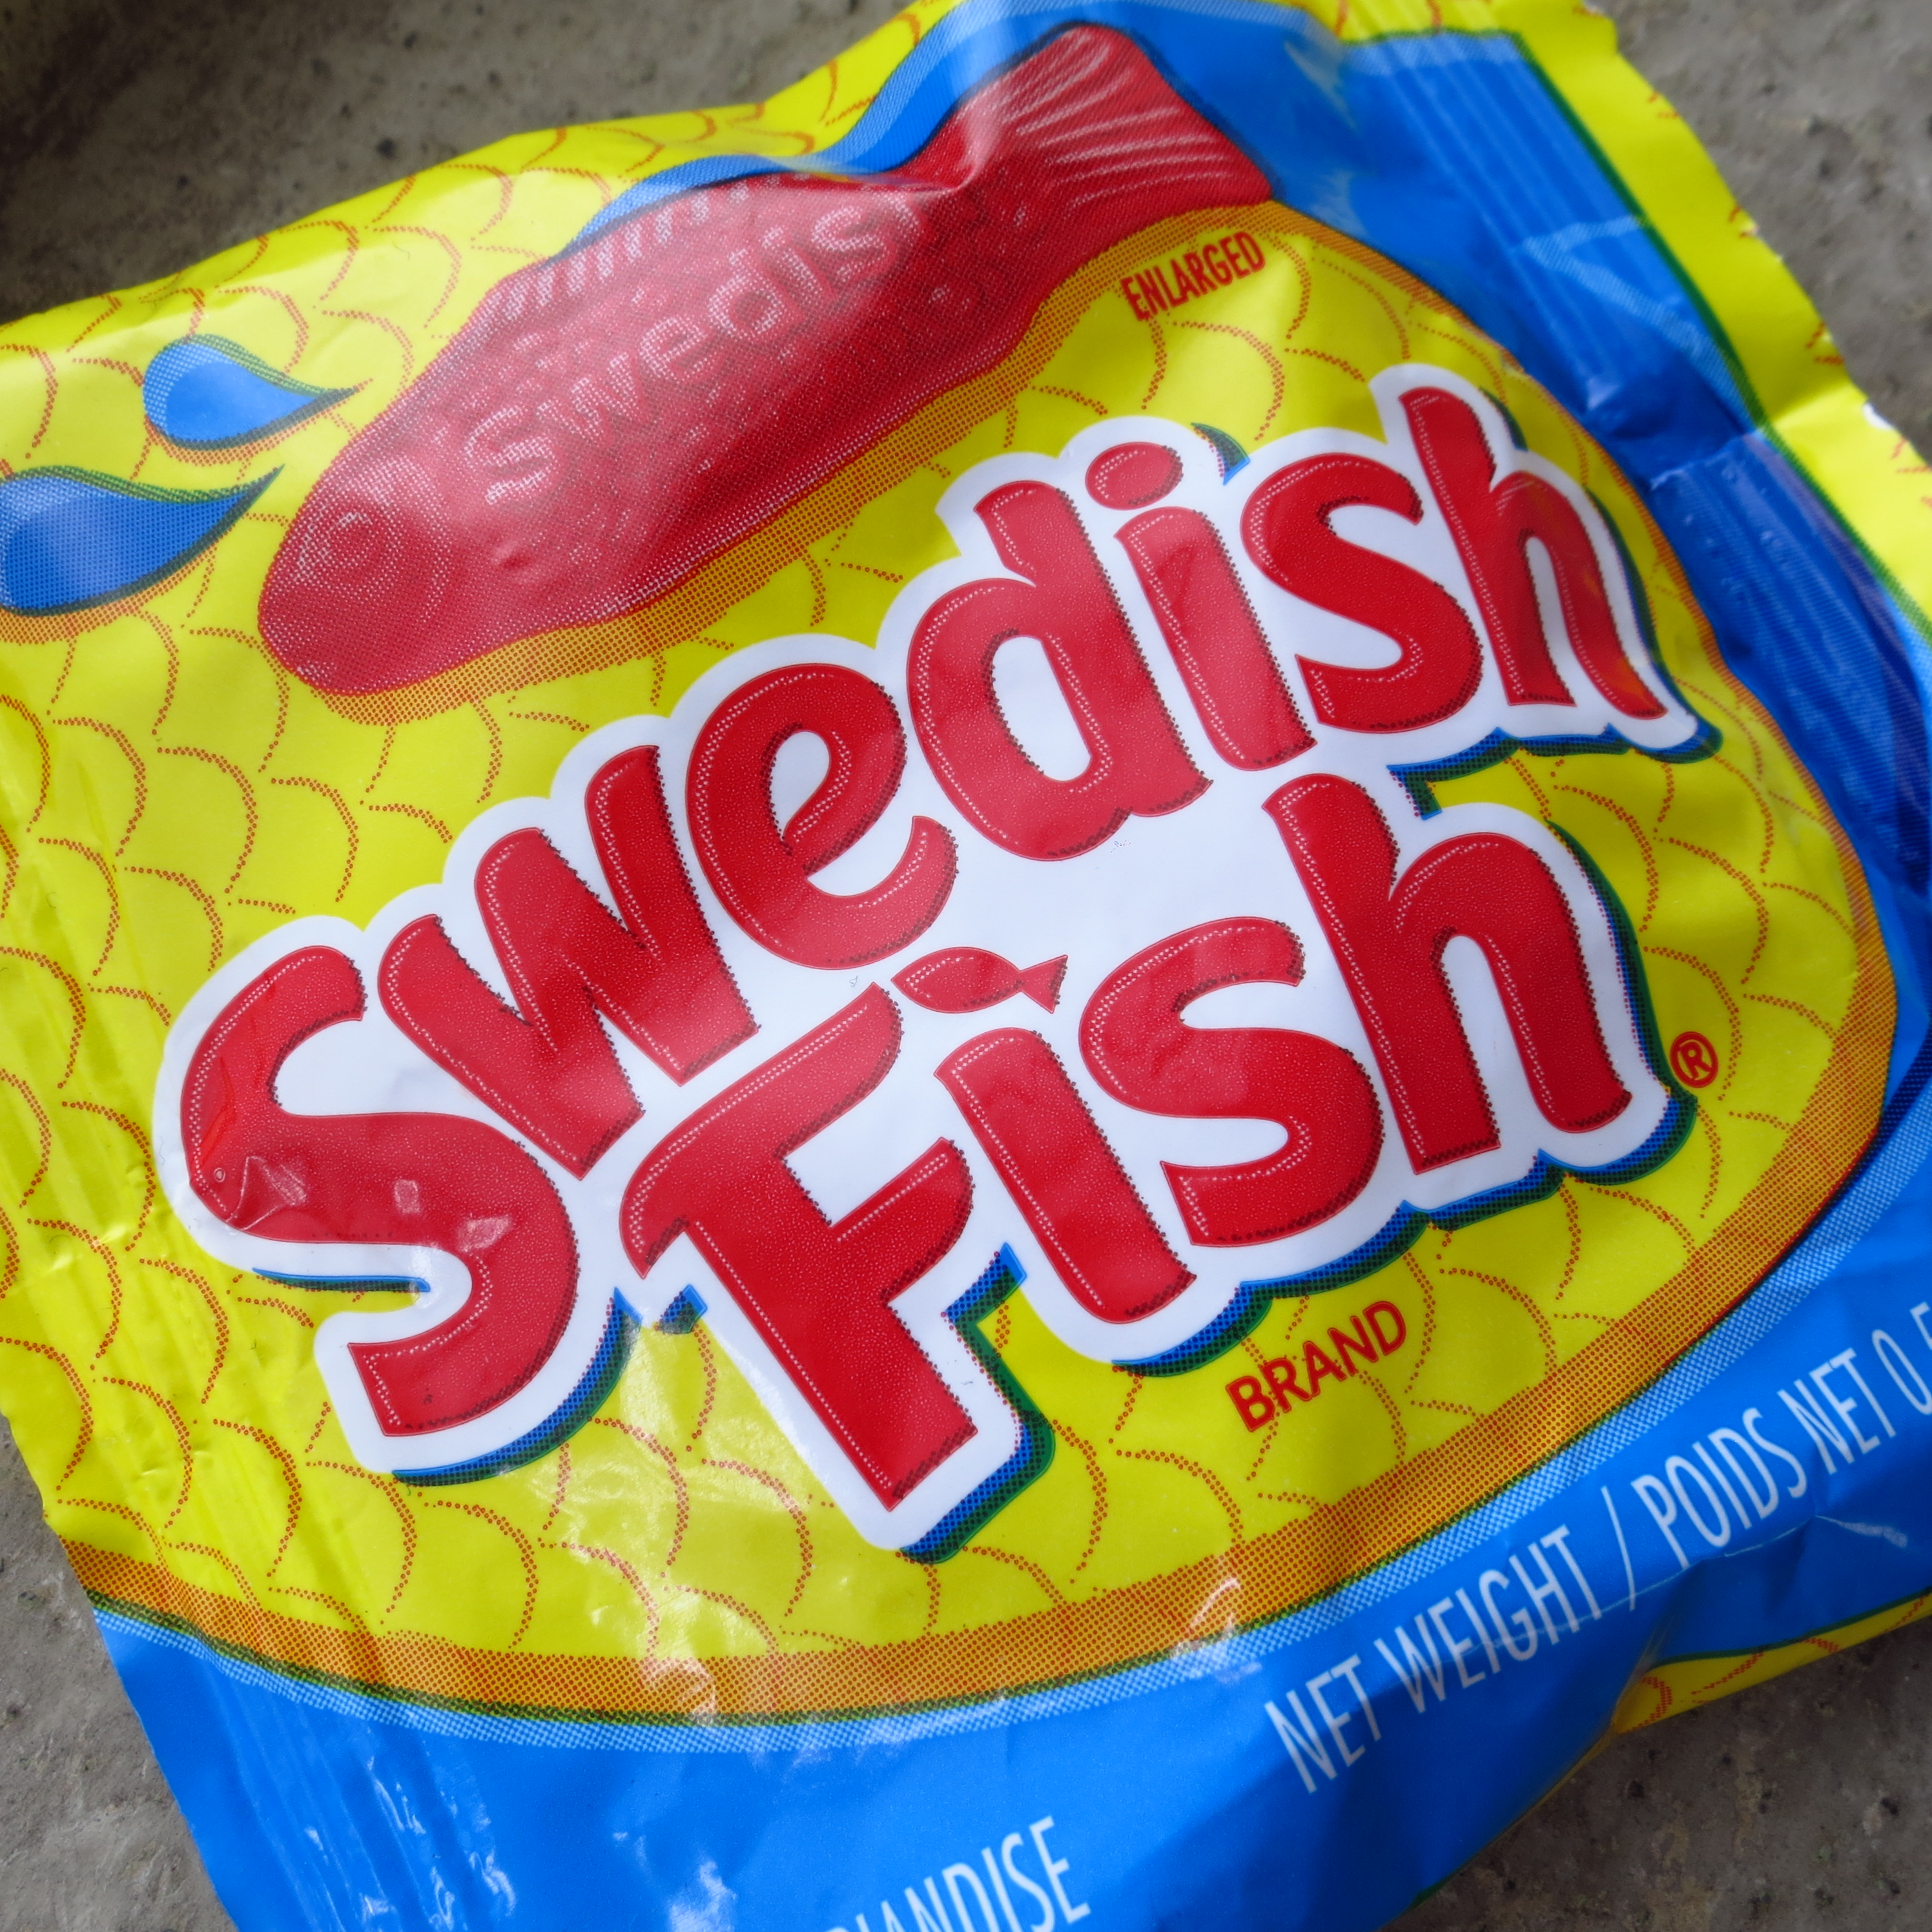
Time FOR LOGISTICS
Tools we will use this year include the following:
GitHub (https://github.com/sql-sith/cdc-2024).
Zulip (https://cyberdefense.zulipchat.com).
Discord is available for team members.
Zoom will be used in each meeting.
Information about these resources will be emailed to you shortly, including invitations to the Zulip and Discord servers. This document will also be posted to our GitHub repository in the cleverly named meeting-notes folder.
This Photo by Unknown Author is licensed under CC BY

